Slide 1

FALL 2023
MIS 381N
Information management
Lecture 9
Sept 20th 2023
Prashant D. Joshi
UT McCombs School of Business (MSBA), The University of Texas at Austin

Slide 2

Objectives
Advanced SQL queries
DML
In-class practice
Questions and discussion

Slide 3
What questions may I answer before we begin …
All questions are good questions

Slide 4
Housekeeping

Slide 5
Housekeeping
Your oracle instance and server are ready for you.
All users need to use the SQL change password site (https://secure.mccombs.utexas.edu/MISSQLPwdChange/default.aspx) to set their password before using SQLdeveloper to access the server. Here are your respective server name and Class ID of students that will be loaded to your instance as “MIS_STUDENT” role
Get the correct information about this. Get the students ready ASAP
To access the server all users need to first setup their password using the SQL change password site: https://secure.mccombs.utexas.edu/MISSQLPwdChange/default.aspx . The user is to select their class from the list.
Once done. Users need to have SQL developer on their machine and create the connection with their respective server.
I will send out detailed steps to do this once I have it on my system as well

Slide 6
Housekeeping

Slide 7
Data Manipulation Language

Slide 8
SQL Overview

Slide 9
SQL Overview - DML

Slide 10
SQL Select Learning Journey
Basic Syntax
Column Functions
Where clauses
Sorting
Joining tables
Summarizing data
Subqueries
PL/SQL

Slide 11
SUBQUERIES

Slide 12
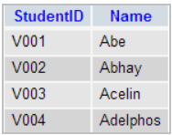
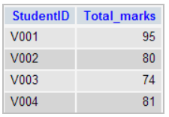
Sometimes the data we need is in multiple tables
Suppose we have the following two tables
Students
Marks
Suppose we need the students who scored more than V002
SELECT *
FROM Marks
WHERE StudentID = ‘V002’
SELECT s.StudentID, s.Name, m.Total_marks
FROM Students s, Marks m
WHERE s.StudentID = m.StudentID
AND m.Total_marks > 80
StudentID | Total_marks
V002 | 80
StudentID | Name | Total_marks
V001 | Abe | 95
V004 | Adelphos | 81
Ref: https://www.w3resource.com

Slide 13
Could we have used JOIN instead?
Students
Marks
SELECT s.StudentID, s.Name, m.Total_marks
FROM Students s JOIN Marks m
ON s.StudentID = m.StudentID
WHERE m.Total_marks > [HOW DO WE GET 80?]
SELECT Total_marks
FROM Marks
WHERE StudentID = ‘V002’
SELECT s.StudentID, s.Name, m.Total_marks
FROM Students s JOIN Marks m
ON s.StudentID = m.StudentID
WHERE m.Total_marks >
(SELECT Total_marks
FROM Marks
WHERE StudentID = ‘V002’
)
BUT WE DON’T NEED TO USE JOIN….

Slide 14
Use a ‘nested’ command
Students
Marks
SELECT s.StudentID, s.Name, m.Total_marks
FROM Students s JOIN Marks m
ON s.StudentID = m.StudentID
WHERE m.Total_marks > [HOW DO WE GET 80?]
SELECT s.StudentID, s.Name, m.Total_marks
FROM Students s JOIN Marks m
WHERE s.StudentID = m.StudentID
AND
m.Total_marks >
(SELECT Total_marks
FROM Marks
WHERE StudentID = ‘V002’
)
This is called a SUBQUERY
StudentID | Name | Total_marks
V001 | Abe | 95
V004 | Adelphos | 81

Slide 15
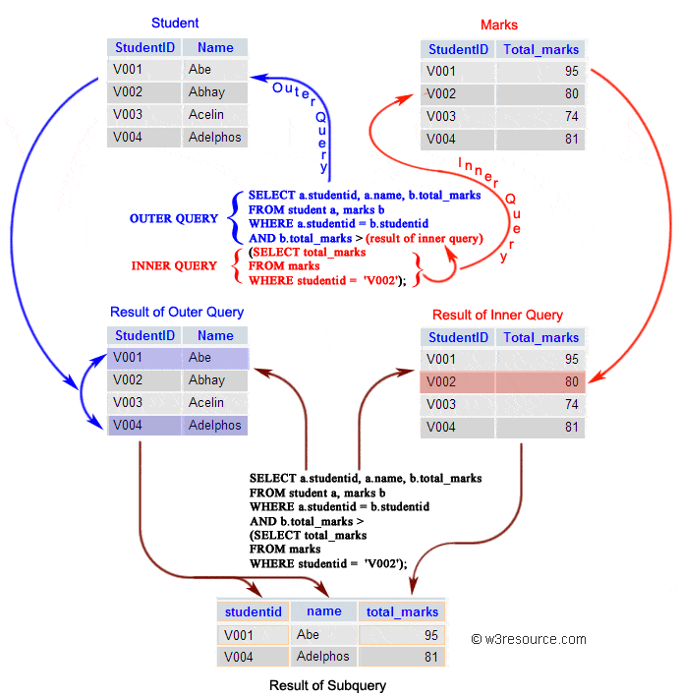
Inner and outer queries
NOTE: Here the inner query is returning
a ‘VALUE’
Ref: https://www.w3resource.com

Slide 16
So, what is a subquery?
A SUBQUERY is an SQL query ‘nested’ inside larger query
A subquery can occur inside
SELECT
FROM
WHERE
Another SUBQUERY
Typical usage is seen in the WHERE clause

Slide 17
Use of SUBQUERIES (often)
Need to filter info from another table (WHERE, HAVING)
Need summary info from another table (SELECT, FROM)
Ned to JOIN another table (SELECT, FROM)

Slide 18
Typical usage
A SUBQUERY can return a value or a list of records
User has to be aware of what is being returned to use appropriately
Comparison operators, such as, =, <, > can be used
Multi-row operators such as IN, ANY, ALL can also be used
The inner most subquery (also called inner query) is executed first

Slide 19
Typical usage
The subquery is a SELECT, INSERT, DELETE, UPDATE etc statement typically is used for
Comparing an expression to the result of the query
Checking to see if an expression is included in the query results
If the query returns any rows
Syntax:
SELECT <list>
FROM <table>
WHERE expression operator
( SELECT <list>
FROM<table>);

Slide 20
Usage rule/guidelines
The subquery must be enclosed in parentheses “(“ and “)”
The subquery must be on the right side of the comparison operator
Subqueries cannot manipulate their own results, hence ORDER BY cannot be used in the subquery, but in the outer query
Use proper operators with the queries (rows, values)
If the subquery returns a null value, the outer querry will not return any rows in the outer WHERE clause

Slide 21
Lets explore some new commands
INSERT INTO overall_toppers
SELECT * FROM department_students
WHERE student_name = ANY (
SELECT student_name FROM class_grades
WHERE grade = “A”);
Department_students
Class_grades
Overall_toppers
Student_name | Student_EID
James | 1
Bond | 2
Amitabh | 3
Bacchan | 4
Student_name | grades
James | A
Bond | B
Amitabh | A
Bacchan | B
Student_name | Student_EID
Bruce | 5
Lee | 6
Student_name | Student_EID
Bruce | 5
Lee | 6
James | 1
Amitabh | 3
New commands: INSERT, ANY

Slide 22
Lets explore some new commands
INSERT INTO overall_toppers
SELECT * FROM department_students
WHERE student_name = ANY (
SELECT student_name FROM class_grades
WHERE grade IN (‘A’, ‘B’));
WHERE grade = ‘A’ OR grade = ‘B’);
Department_students
Class_grades
Overall_toppers
Student_name | Student_EID
James | 1
Bond | 2
Amitabh | 3
Bacchan | 4
Student_name | grades
James | A
Bond | B
Amitabh | C
Bacchan | D
Student_name | Student_EID
Bruce | 5
Lee | 6
Student_name | Student_EID
Bruce | 5
Lee | 6
James | 1
Bond | 2
New commands: IN
It can replace multiple OR expressions

Slide 23
Self study
Explore how you can do the same with the following:
UPDATE
DELETE

Slide 24
Subquery in FROM
SELECT v.vendor_id, vendor_name, vendor_city
FROM vendors v JOIN
(SELECT vendor_id, min(payment_date)
FROM invoices
GROUP BY vendor_id) i
ON v.vendor_id = i.vendor_id;

Slide 25
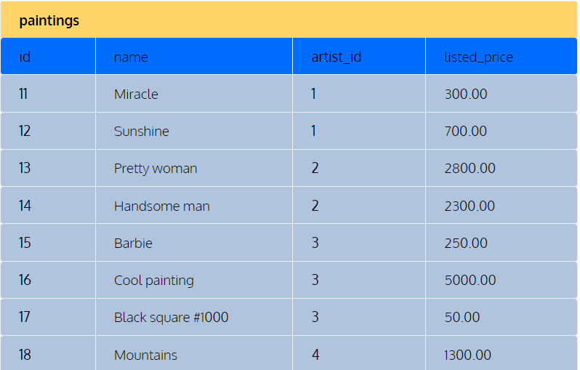
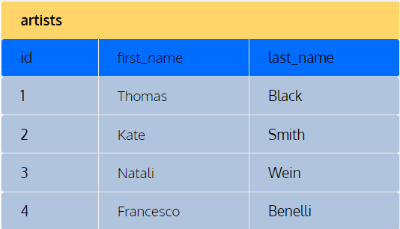
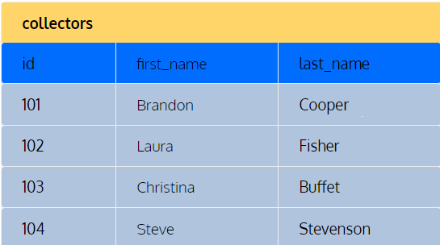
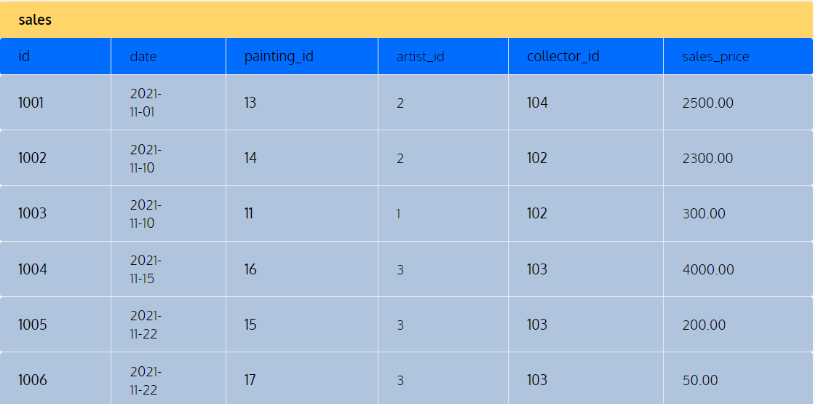
In Class examples

Slide 26
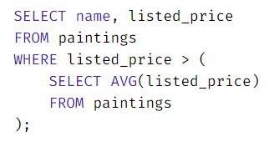
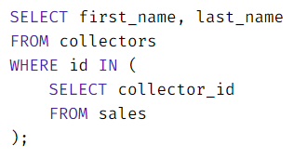
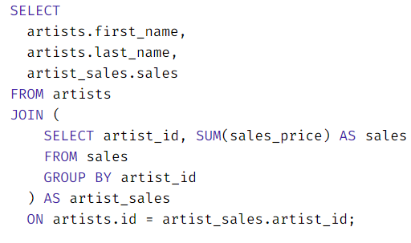
In Class study
List all paintings that are priced higher than average
List all collectors who purchased paintings from the gallery
List the total amount of sales for EACH artist who has sold AT LEAST one painting in the gallery

Slide 27
What questions may I answer before we conclude …
All questions are good questions

